Slide 1
BFI Data Analysis
by Shamir Ashraf

Slide 2
Project Goal
To understand key revenue trends and factors in the film industry.
It helps identify which distributors are generating the most revenue, how revenue changes over time.
provides insights into the overall performance of film releases.
These findings are crucial for making informed decisions on film distribution, marketing strategies, and release timing.

Slide 3
Key Questions
1. Which distributors are generating the most revenue?
2. How is the revenue changing over time?
3. Which films are experiencing significant week-over-week changes in revenue?
4. Do more film releases correlate with higher overall weekend gross?
5. Are there particular weeks where films tend to generate more cumulative revenue?

Slide 4
Findings & Insights

Slide 5
1. Which distributors are generating the most revenue?

Slide 6
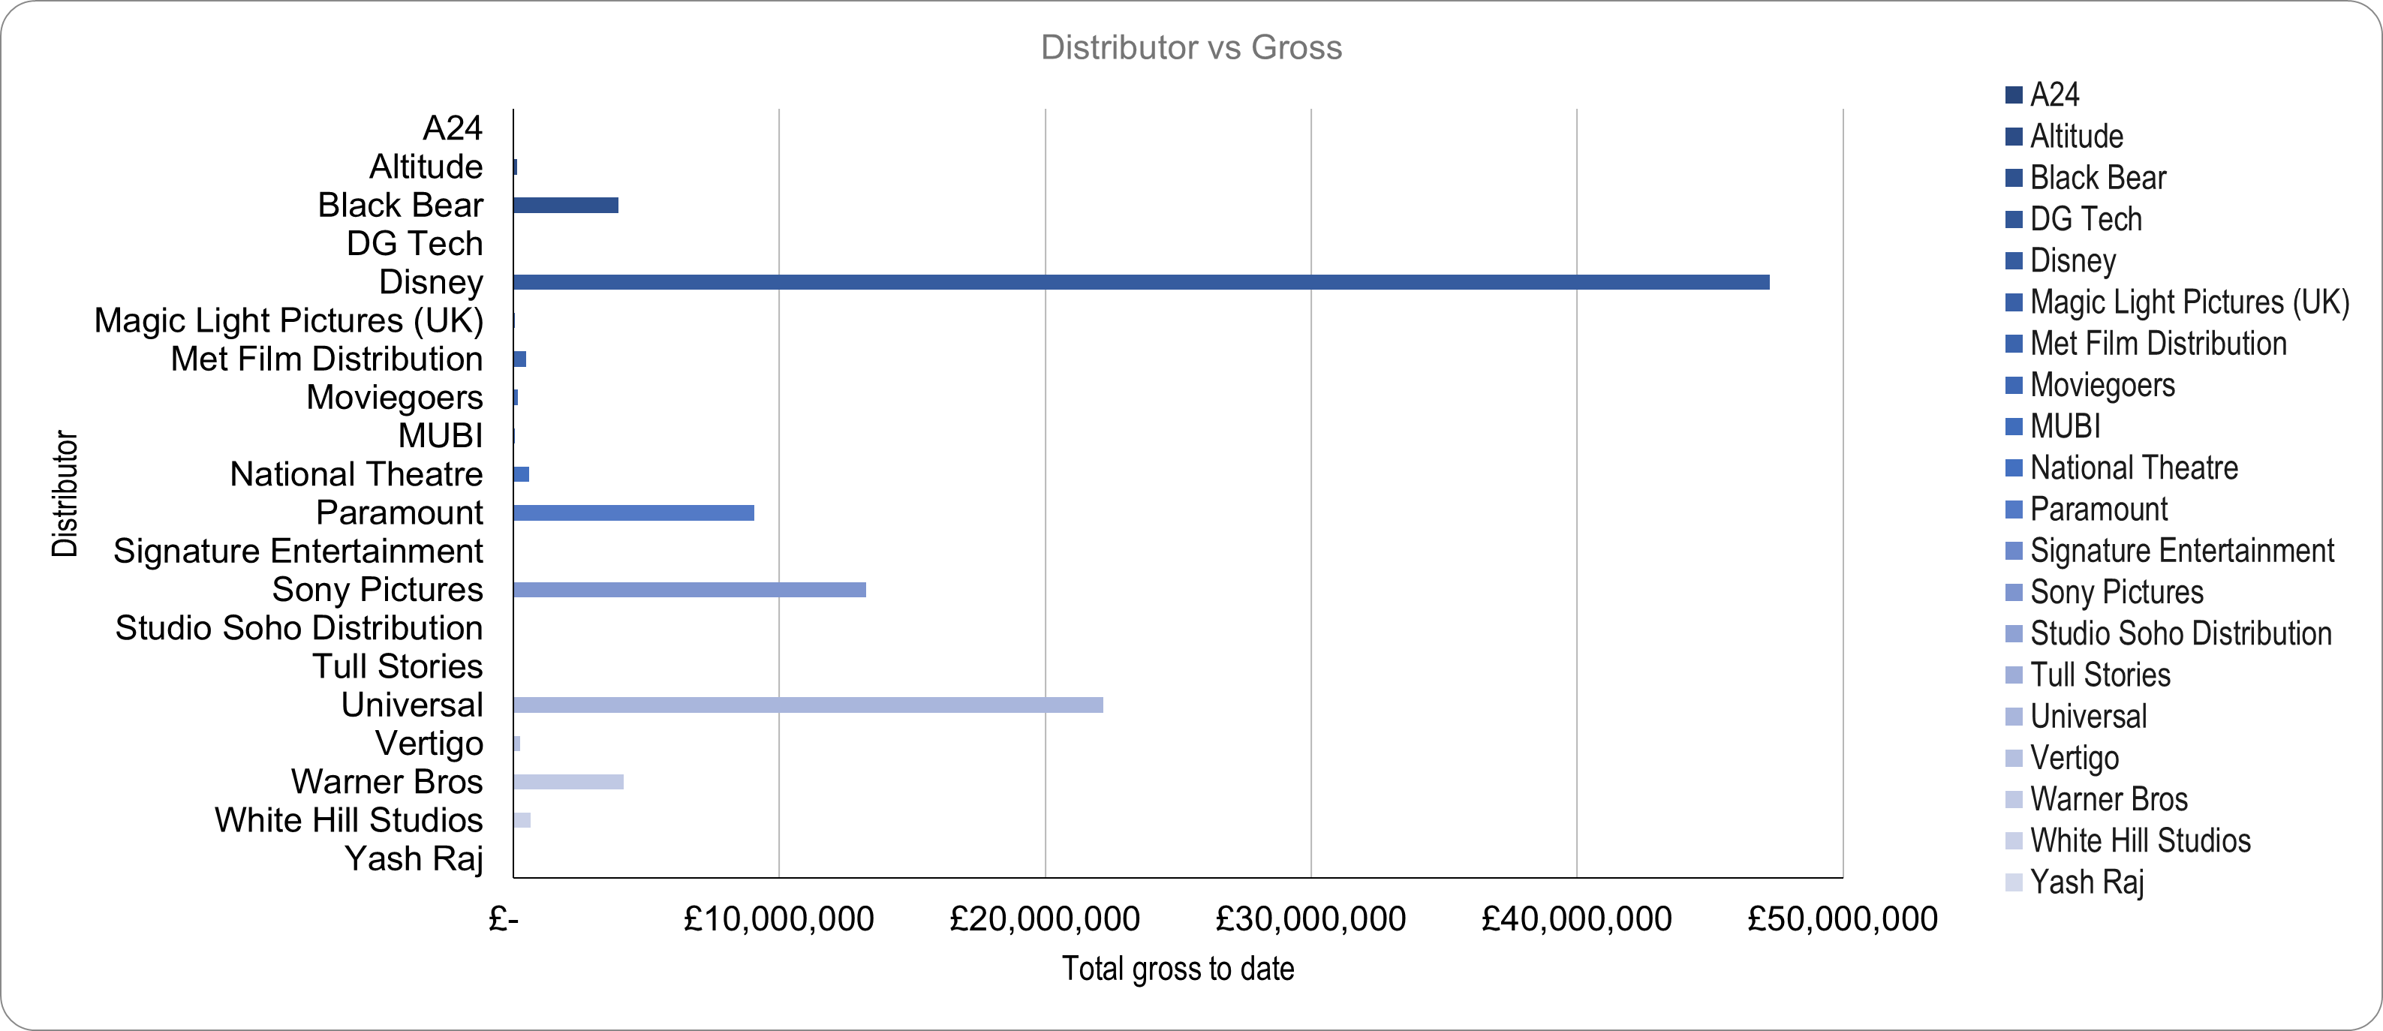
1. Which distributors are generating the most revenue?

Slide 7
1. Which distributors are generating the most revenue?

Slide 8
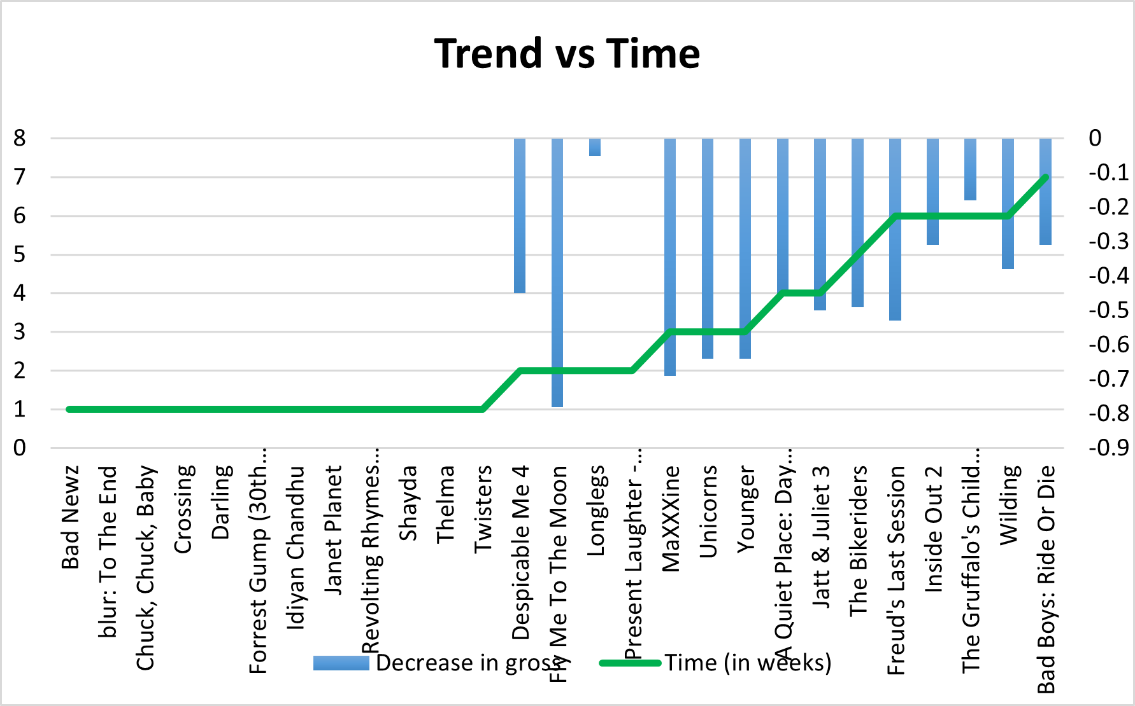
2. How is the revenue changing over time?

Slide 9
2. How is the revenue changing over time?

Slide 10
2. How is the revenue changing over time?

Slide 11
3. Which films are experiencing significant week-over-week changes in revenue?

Slide 12
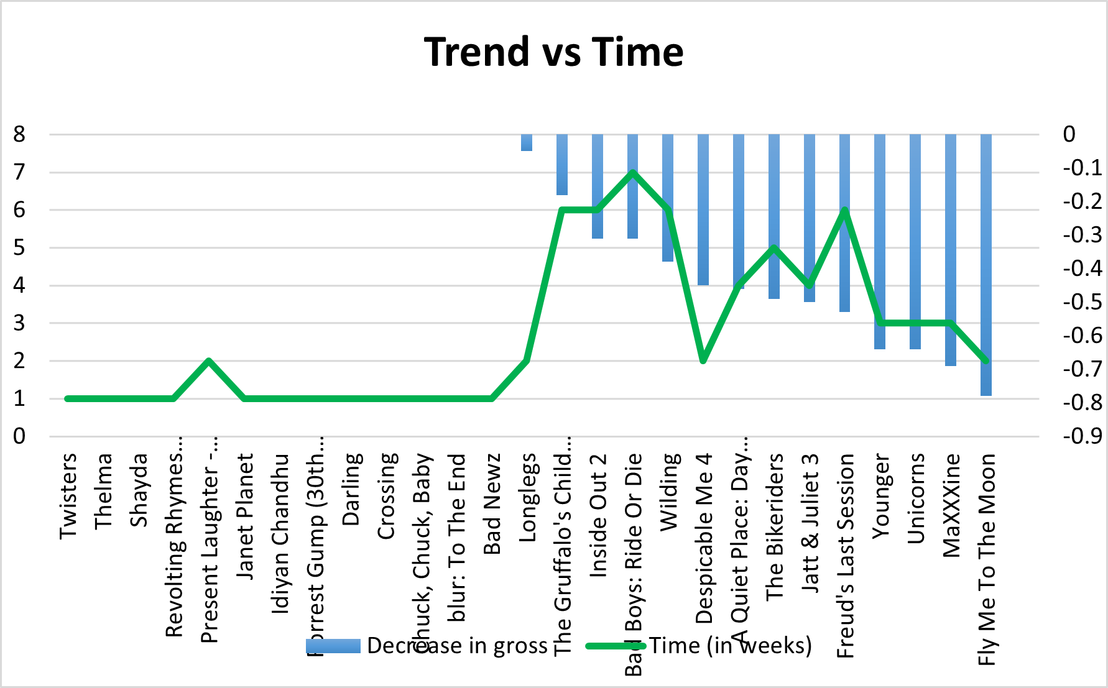
3. Which films are experiencing significant week-over-week changes in revenue?

Slide 13
3. Which films are experiencing significant week-over-week changes in revenue?

Slide 14
4. Do more film releases correlate with higher overall weekend gross?

Slide 15
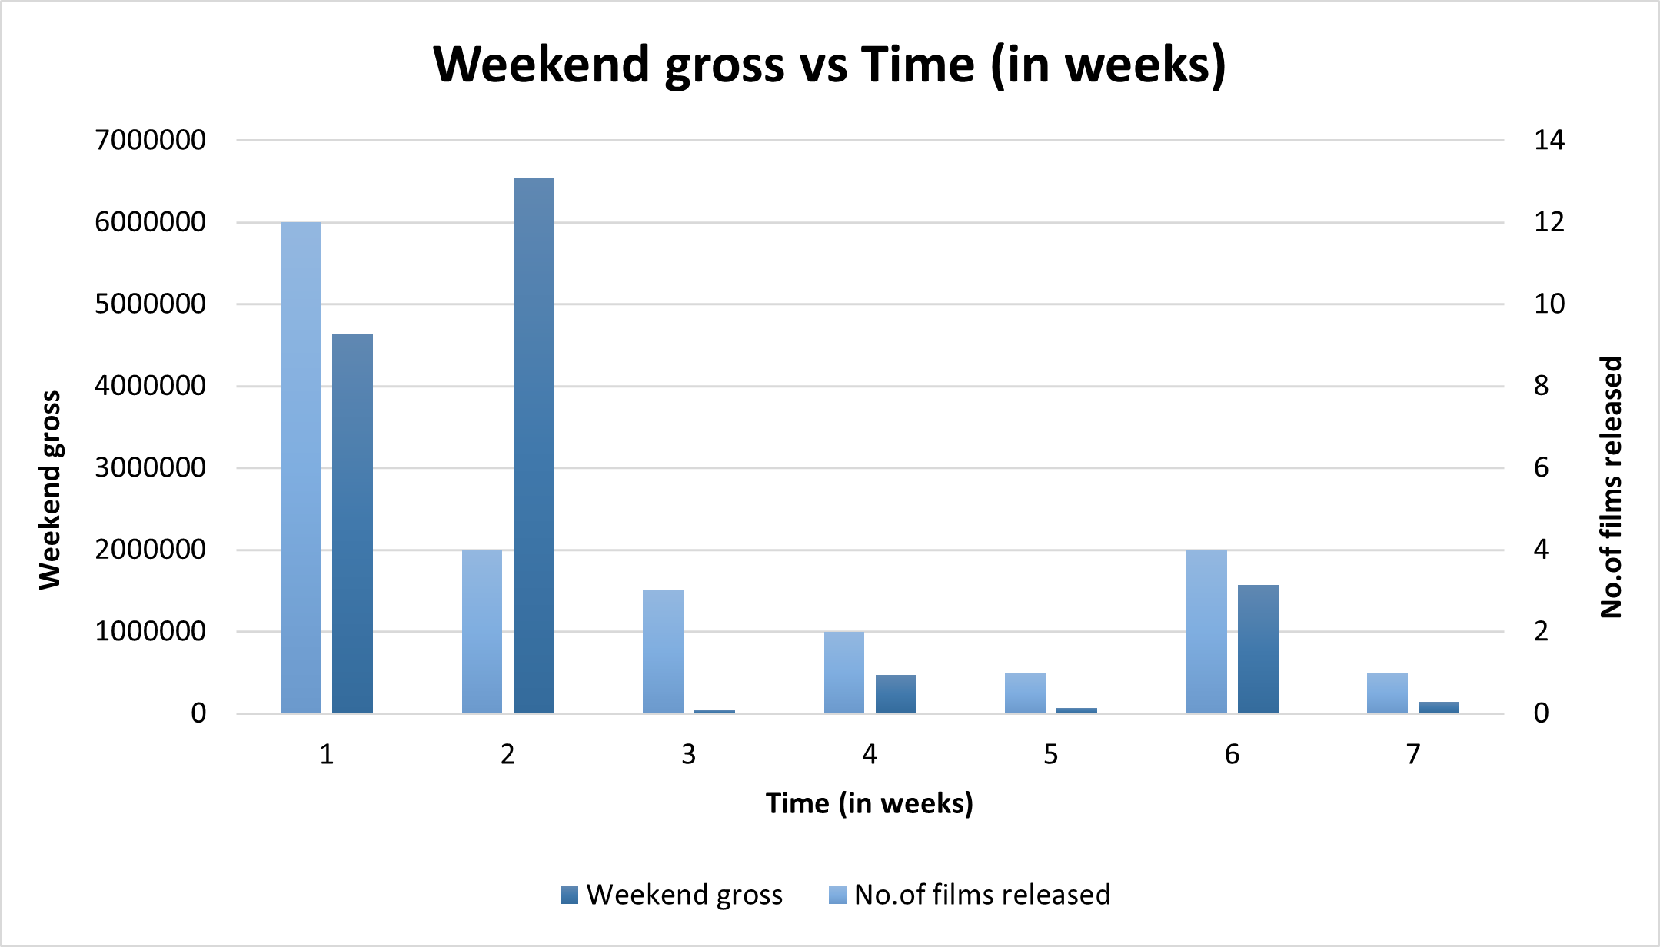
4. Do more film releases correlate with higher overall weekend gross?

Slide 16
4. Do more film releases correlate with higher overall weekend gross?

Slide 17
5. Are there particular weeks where films tend to generate more cumulative revenue?

Slide 18
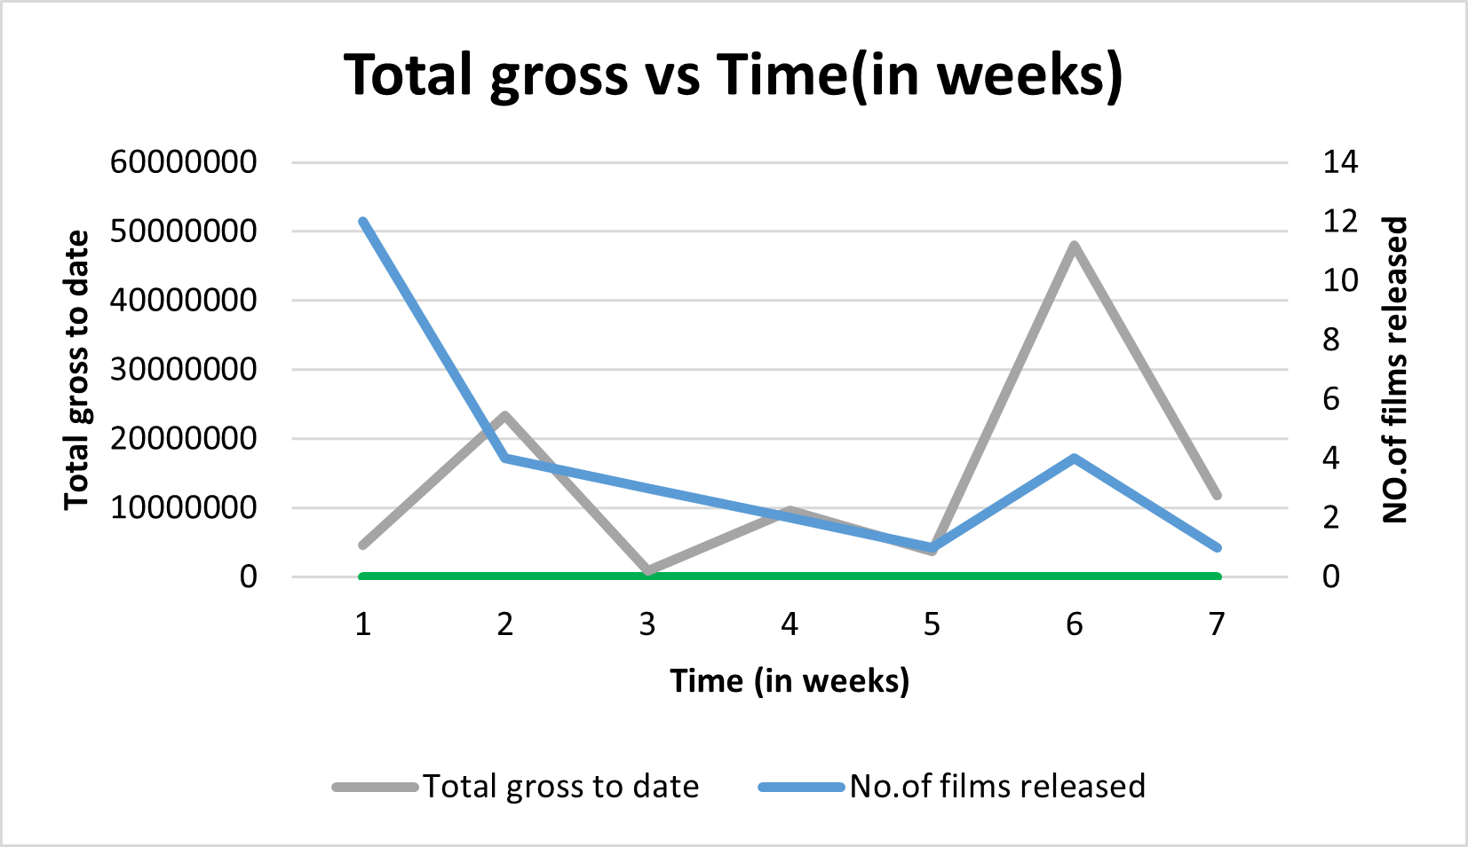
5. Are there particular weeks where films tend to generate more cumulative revenue?

Slide 19
5. Are there particular weeks where films tend to generate more cumulative revenue?

Slide 20
Summary

Slide 21
Summary of Findings
1. The top distributors have significant control over the market, but there is room for growth with other players.
2. Revenue trends vary significantly week by week, with some films showing remarkable consistency.
3. The number of films released does not directly correlate with higher weekend gross; trends and timing are key.

Slide 22
Action & Recommendations

Slide 23
Recommended Actions
1. Focus marketing efforts on top-performing distributors and consider partnerships with emerging ones.
2. Optimize release strategies based on week-over-week trends to maximize revenue potential.
3. Prioritize films expected to trend rather than increasing the number of releases.

Slide 24
Thank You!

